Slide 1

GEOG 4/590: Geospatial Data Science
Lecture 4.5: Previous class projects
Email: jryan4@uoregon.edu
Office: 163A Condon Hall
Office hours: Monday 14:00-16:00

Slide 2
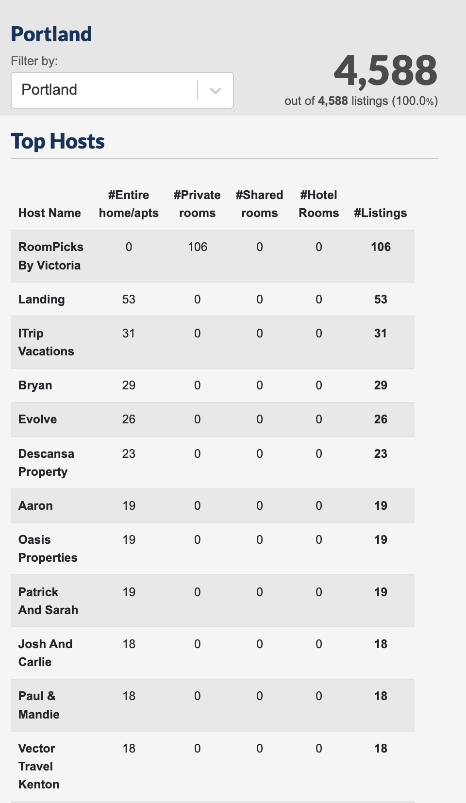
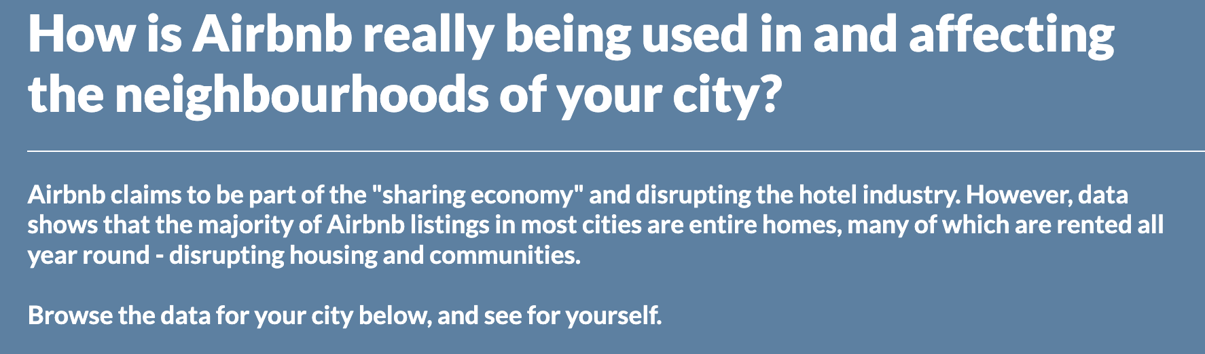
Machine learning AirBnB rates in Portland
https://insideairbnb.com/

Slide 3
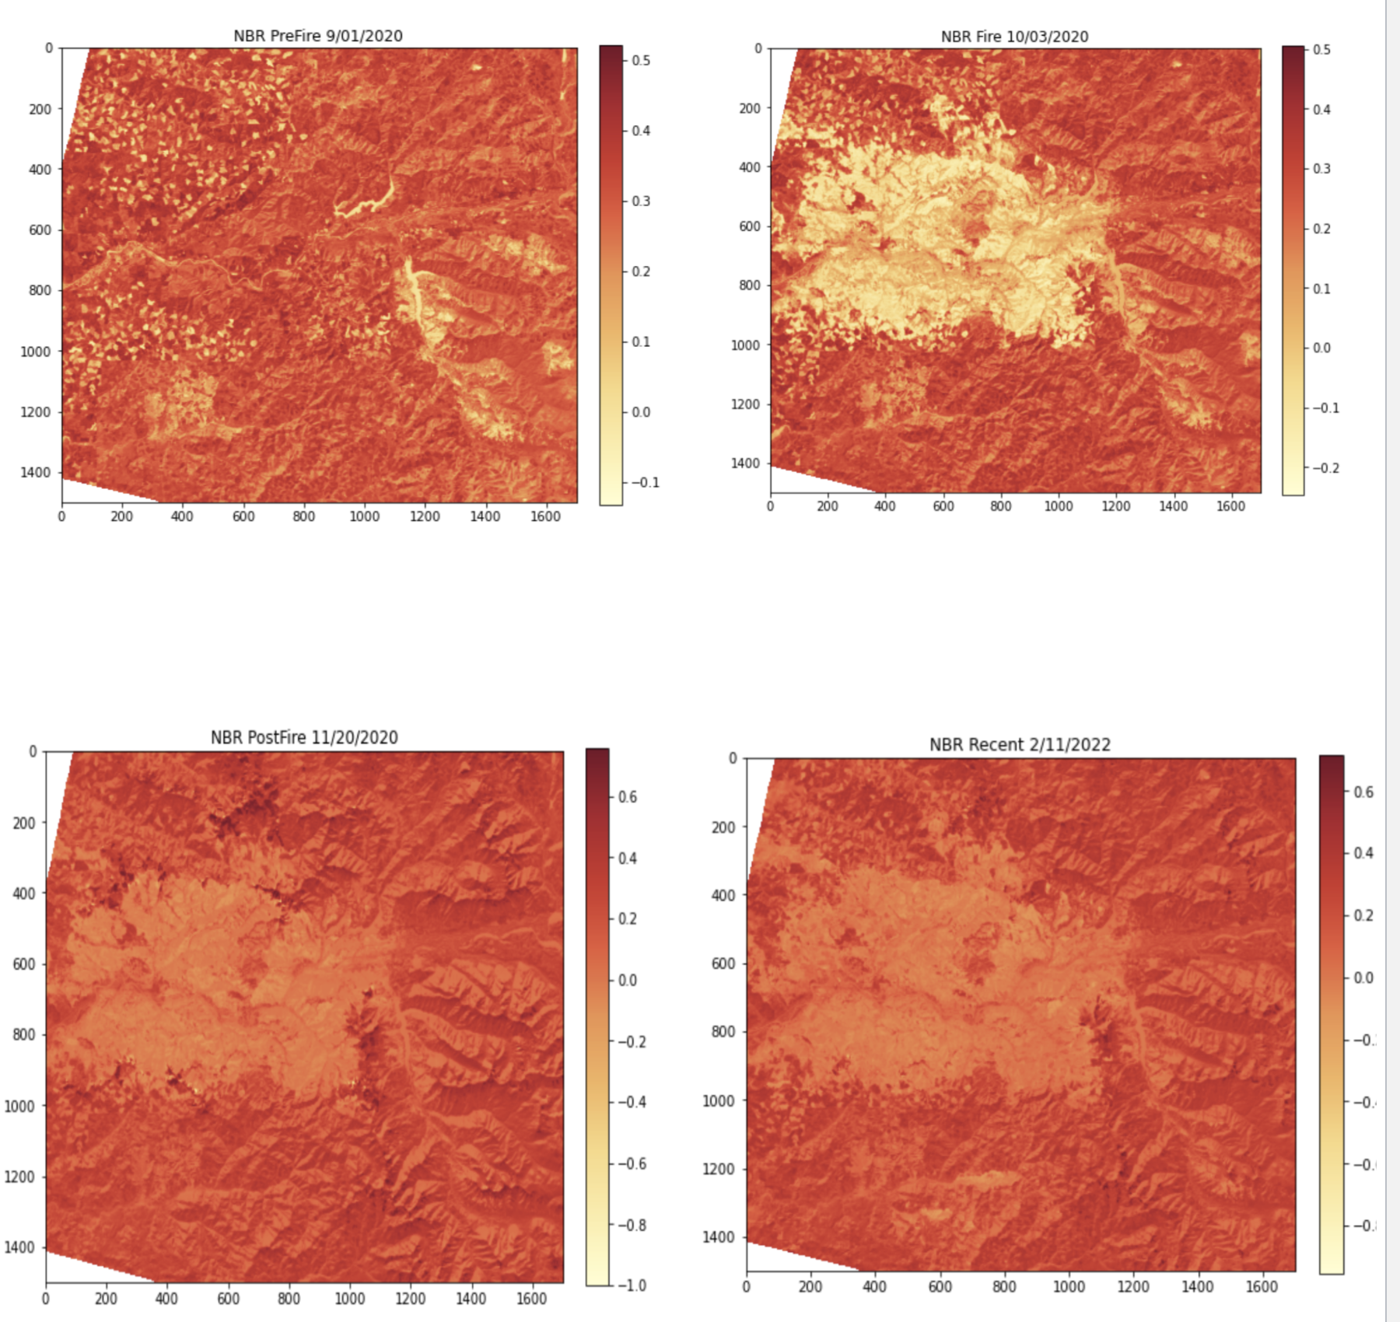
Post-fire vegetation recovery for the Holiday Farm Fire, Oregon
Notes:
Four Landsat images

Slide 4
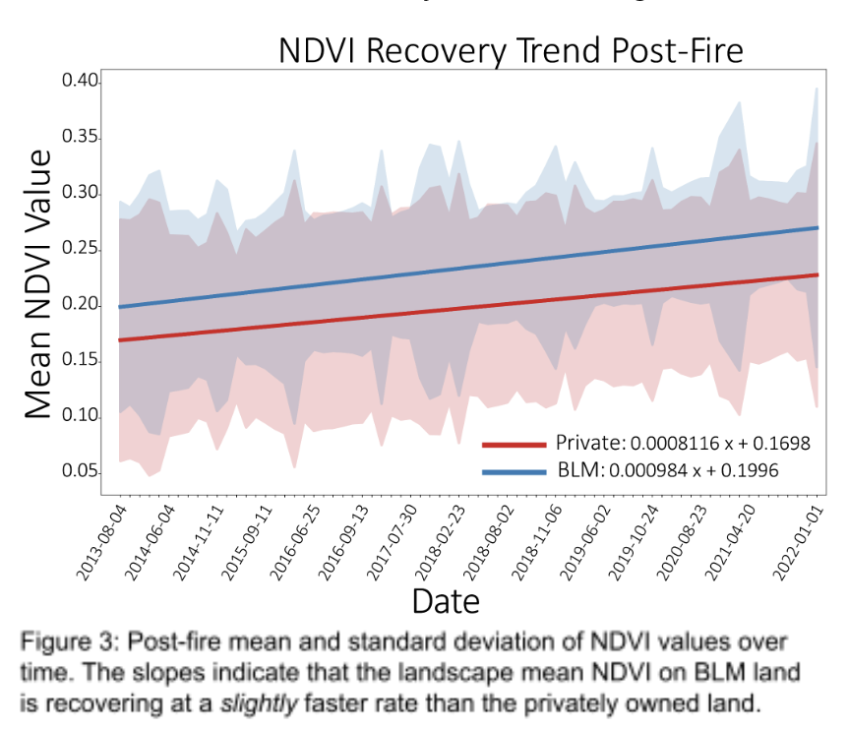
Post-fire Vegetation Recovery for the Douglas Fire Complex, Oregon
Notes:
92 Landsat images in Google colab

Slide 5
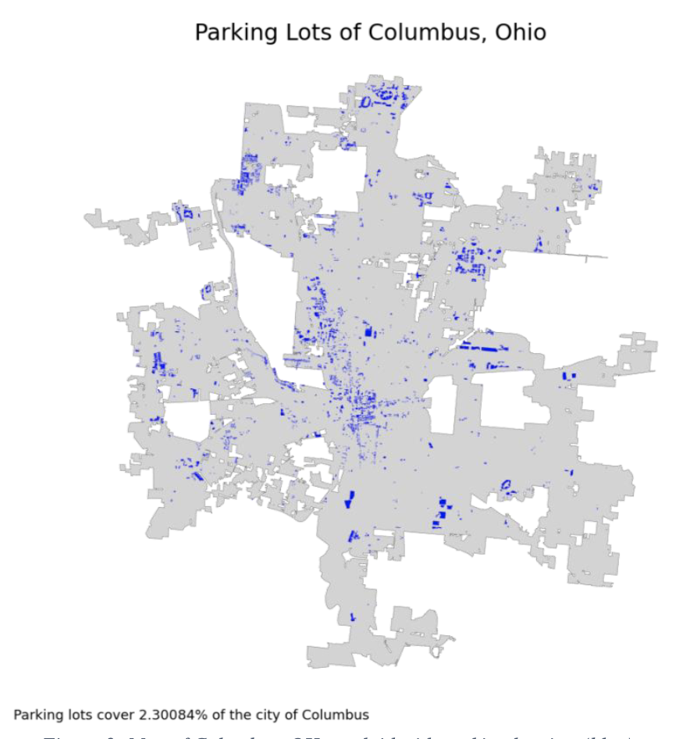
Parking lot surface area coverage in U.S. Cities
OSMnx to download geospatial data from OpenStreetMap that contained the tag “parking”

Slide 6
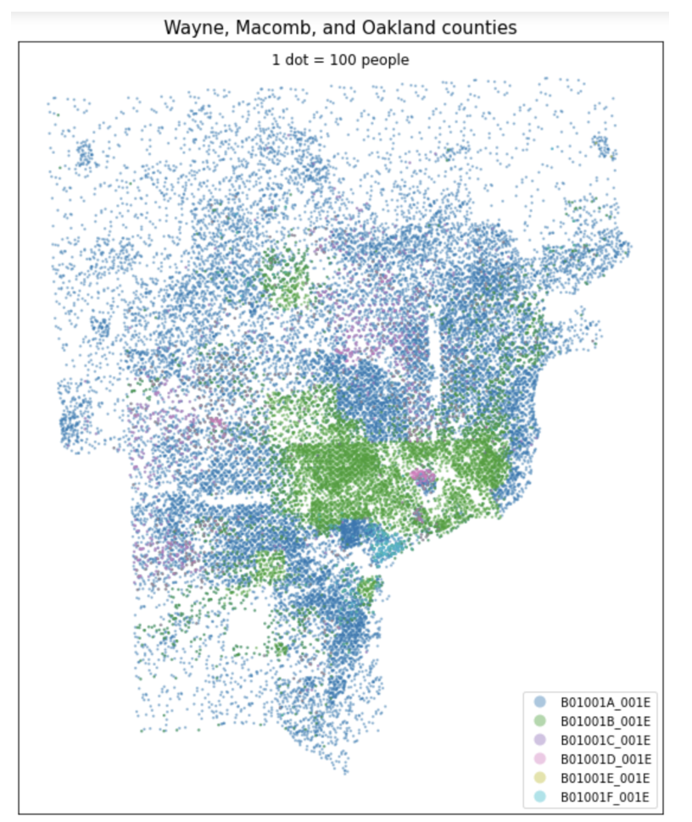
Spatial distributions of COVID-19 vaccine availability according to race
OSMnx to download street network data from OpenStreetMap to compute walking and driving distances to nearest vaccination clinic.
census package to download population and race/ethnicity data for Detroit, Michigan
Won the Trussell Family Scholarship ($2000)
Notes:
Detroit

Slide 7
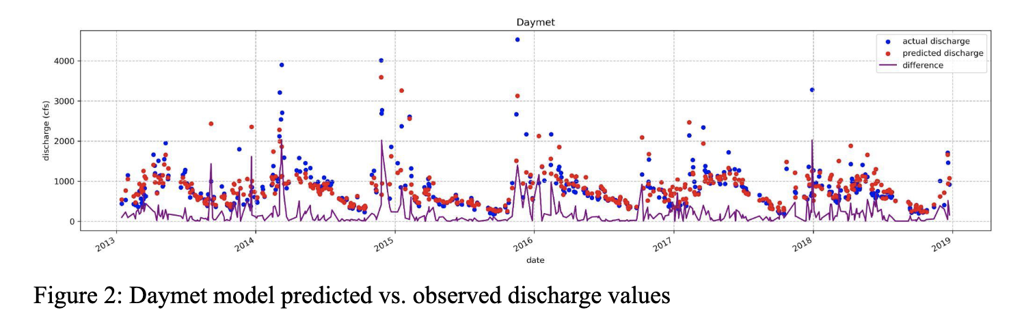
Machine learning the discharge of the Nisqually River
Notes:
Detroit

Slide 8
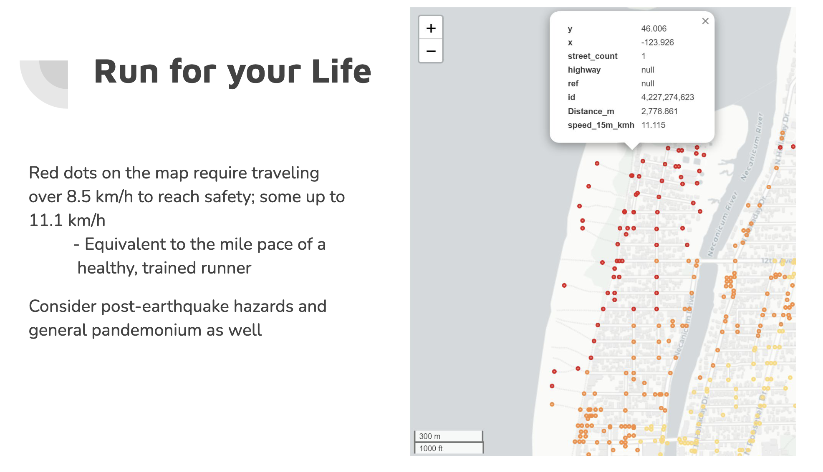
Tsunami evacuation times
Notes:
Seaside Oregon

Slide 9
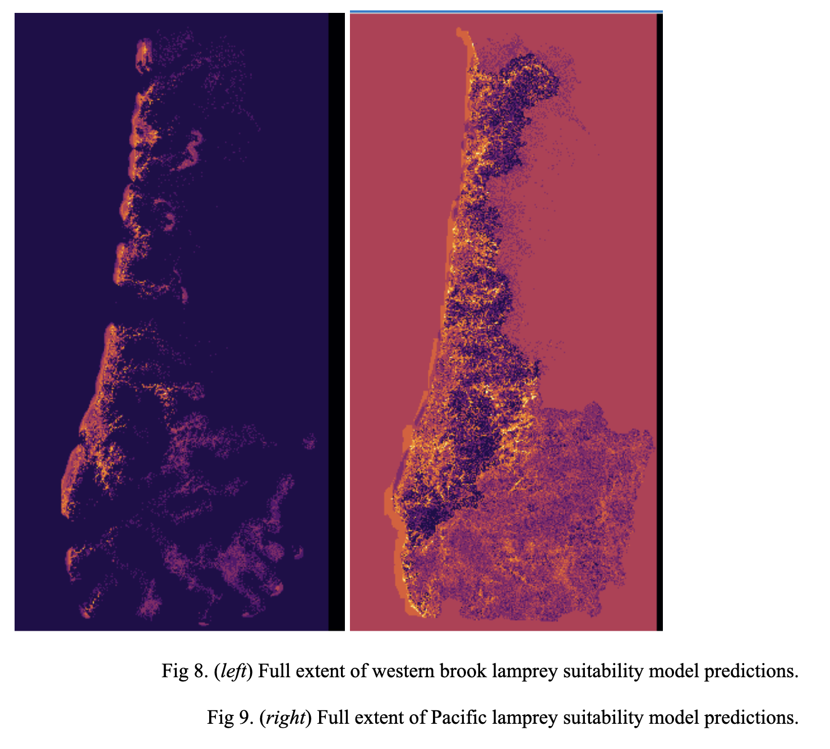
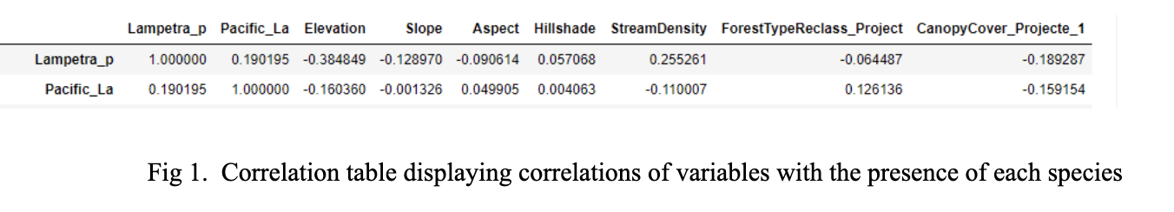
Lamprey habitat suitability modeling
Notes:
Seaside Oregon

Slide 10


